Slide 1
ORGANISM AND POPULATION
CLASS XII CHAPTER 13

Slide 2
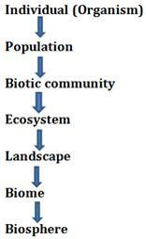

Slide 3
Major biomes
Regional and local variations within each biome lead to the formation of a wide variety of habitats.
Major biomes of India are shown in Figure 13.2.
On planet Earth, life exists not just in a few favourable habitats but even in extreme and harsh habitats – scorching Rajasthan desert, perpetually rain-soaked Meghalaya forests, deep ocean trenches, torrential streams, permafrost polar regions, high mountain tops, boiling thermal springs,and stinking compost pits, to name a few.
Even our intestine is a unique habitat for hundreds of species of microbes.

Slide 4
BIOMES
1.DESERT
2.GRASSLAND
3.TROPICAL RAIN FOREST
4.TEMPERATE FOREST
5.CONIFEROUS FOREST
6.ARCTIC AND ALPINE TUNDRA

Slide 5
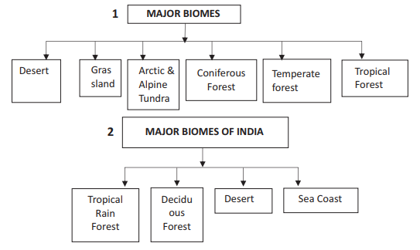

Slide 6
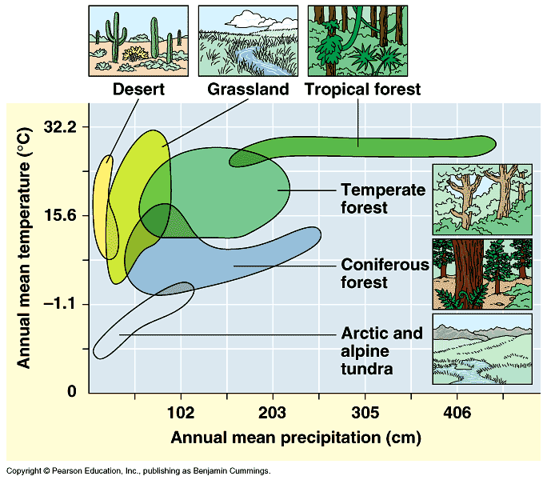

Slide 8
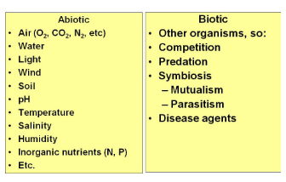

Slide 9
ABIOTIC FACTOR
1. Temperature is the most ecologically relevant environmental factor.
The average temperature on land varies seasonally, decreases progressively from the equator towards the poles and from plains to the mountain tops.
It ranges from subzero levels in polar areas and high altitudes to >50 deg C in tropical deserts in summer.
There are, however, unique habitats such as thermal springs and deep-sea hydrothermal vents where average temperatures exceed 100degree C.

Slide 10
Temperature
A few organisms can tolerate and thrive in a wide range of temperatures (they are called eurythermal),
vast majority of them are restricted to a narrow range of temperatures (such organisms are called stenothermal).
The levels of thermal tolerance of different species determine to a large extent their geographical distribution.

Slide 12
Abiotic Factor
2.Water: water is the most important factor influencing the life of organisms.
In fact, life on earth originated in water and is unsustainable without water. Its availability is so limited in deserts that only special adaptations make it possible to live there.
The productivity and distribution of plants is also heavily dependent on water.

Slide 13
WATER
The salt concentration (measured as salinity in parts per thousand), is less than 5 in inland waters, 30-35 in the sea and > 100 per cent in some hypersaline lagoons.
Some organisms are tolerant of a wide range of salinities (euryhaline) but others are restricted to a narrow range (stenohaline).

Slide 14
Abiotic Factor
3.Light: Since plants produce food through photosynthesis, a process which is only possible when sunlight is available as a source of energy,
Many species of small plants (herbs and shrubs) growing in forests are adapted to photosynthesise optimally under very low light conditions because they are constantly overshadowed by tall, canopied trees.

Slide 15
Light
Many plants are also dependent on sunlight to meet their photoperiodic requirement for flowering.
Light is important in that they use the diurnal and seasonal variations in light intensity and duration (photoperiod) as cues for timing their foraging, reproductive and migratory activities.
The availability of light on land is closely linked with that of temperature since the sun is the source for both.

Slide 16
Abiotic Factor
3.Soil: The nature and properties of soil in different places vary;
It is dependent on the climate, the weathering process, whether soil is transported or sedimentary and how soil development occurred.
Various characteristics of the soil such as soil composition, grain size and aggregation determine the percolation and water holding capacity of the soils.
These characteristics along with parameters such as pH, mineral composition and topography determine to a large extent the vegetation in any area.

Slide 17
Organisms cope with the situation
(i) Regulate: Some organisms are able to maintain homeostasis by physiological (sometimes behavioural also) means which ensures constant body temperature, constant osmotic concentration, etc.
All birds and mammals, and a very few lower vertebrate and invertebrate species are indeed capable of such regulation (thermoregulation and osmoregulation).
Evolutionary biologists believe that the ‘success’ of mammals is largely due to their ability to maintain a constant body temperature and thrive whether they live in Antarctica or in the Sahara desert.

Slide 18
Regulate
The mechanisms used by most mammals to regulate their body temperature are similar to the ones that we humans use.
We maintain a constant body temperature of 37C.
In summer, when outside temperature is more than our body temperature, we sweat profusely.
The resulting evaporative cooling, similar to what happens with a desert cooler in operation, brings down the body temperature.
In winter when the temperature is much lower than 37C, we start to shiver, a kind of exercise which produces heat and raises the body temperature.

Slide 19
(ii) Conform: An overwhelming majority (99 per cent) of animals and nearly all plants cannot maintain a constant internal environment.
Their body temperature changes with the ambient temperature.
In aquatic animals, the osmotic concentration of the body fluids change with that of the ambient water osmotic concentration.
These animals and plants are simply conformers. Considering the benefits of a constant internal environment to the organism.

Slide 20
(iii) Migrate : The organism can move away temporarily from the stressful habitat to a more hospitable area and return when stressful period is over.
Many animals, particularly birds, during winter undertake long-distance migrations to more hospitable areas.
Every winter the famous Keolado National Park (Bharatpur) in Rajasthan host thousands of migratory birds coming from Siberia and other extremely cold northern regions.

Slide 21
(iv) Suspend: In bacteria, fungi and lower plants, various kinds of thickwalled spores are formed which help them to survive unfavourable conditions – these germinate on availability of suitable environment.
In higher plants, seeds and some other vegetative reproductive structures serve as means to tide over periods of stress besides helping in dispersal –
They germinate to form new plants under favourable moisture and temperature conditions. They do so by reducing their metabolic activity and going into a state of ‘dormancy’.

Slide 22
In animals, the organism, if unable to migrate, might avoid the stress by escaping in time. The familiar case of bears going into hibernation during winter is an example of escape in time.
Some snails and fish go into aestivation to avoid summer–related problems-heat and dessication. Under unfavourable conditions
many zooplankton species in lakes and ponds are known to enter diapause, a stage of suspended development.

Slide 23
ADAPTATION
Many desert plants have a thick cuticle on their leaf surfaces and have their stomata arranged in deep pits to minimise water loss through transpiration.
They also have a special photosynthetic pathway (CAM) that enables their stomata to remain closed during day time.
Some desert plants like Opuntia, have no leaves – they are reduced to spines–and the photosynthetic function is taken over by the flattened stems.

Slide 24
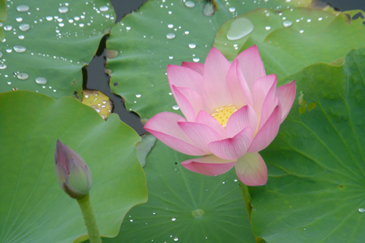
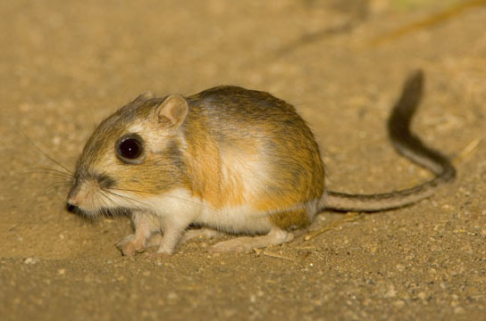
Aquatic Plants: Have evolved aerenchyma for buoyancy and floating. leaves have waxy covering.
Desert animal: Kangaroo rat living in the desert of North America never drink water. The water requirement is by internal fat oxidation (in which water is the by product).
It is also able to concentrate its urine so that the minimal volume of water is lost during excretion

Slide 25
Allen Rule
Mammals from colder climates generally have shorter ears and limbs to minimise heat loss. (This is called the Allen’s Rule.)
In the polar seas aquatic mammals like seals have a thick layer of fat (blubber) below their skin that acts as an insulator and reduces loss of body heat.

Slide 26
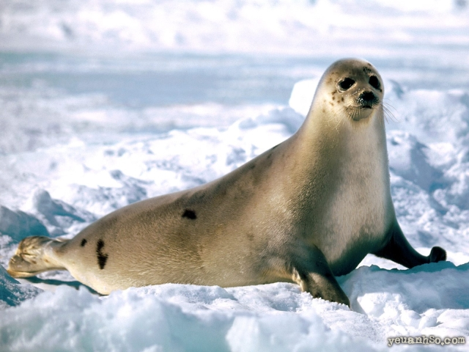
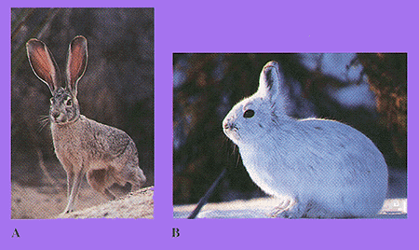
Allen’s rule: Allen’s rule states that, animals from colder climates generally have Shorter ears and limbs to minimize the heat loss.
In Polar seals have a thick layer of fat below the skin that acts as insulator.
It reduces loss of body heat. Short ears and limbs minimize heat loss.

Slide 27
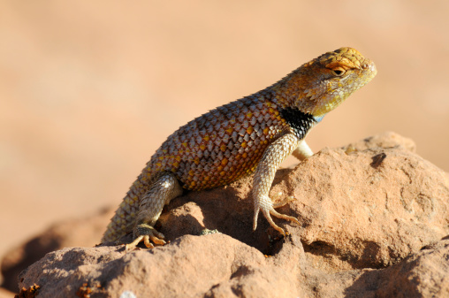
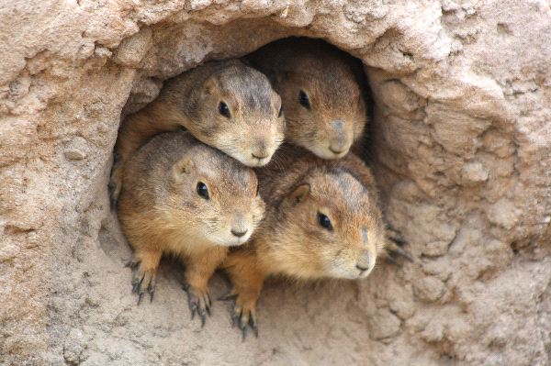
Desert Lizards keep their body temperature constant by behavioral adaptation. They bask in the sun and absorb the heat when their body temperature decreases below the comfort zone.
Burrowing habit also helps to protect desert animals from high temperature

Slide 28
Some organisms possess adaptations that are physiological which allow them to respond quickly to a stressful situation.
In high altitude place (>3,500m Rohtang Pass near Manali and Mansarovar, in China occupied Tibet) person is suffering from nausea, fatigue and heart palpitations and known as altitude sickness
This is because in the low atmospheric pressure of high altitudes, the body does not get enough oxygen. But, gradually you get acclimatised and stop experiencing altitude sickness.
The body compensates low oxygen availability by increasing red blood cell production, decreasing the binding affinity of hemoglobin and by increasing breathing rate.

Slide 29
In most animals, the metabolic reactions and hence all the physiological functions proceed optimally in a narrow temperature range (in humans, it is 37C).
But there are microbes (archaebacteria) that flourish in hot springs and deep sea hydrothermal vents where temperatures far exceed 100C.

Slide 30
POPULATION
In nature, we rarely find isolated, single individuals of any species; majority of them live in groups in a well defined geographical area, share or compete for similar resources, potentially interbreed and thus constitute a POPULATION.

Slide 31
Population Attributes
Population has birth rates and death rates.
In a population these rates refer to per capita births and deaths, respectively.
The rates, hence, expressed is change in numbers (increase or decrease) with respect to members of the population.
Here is an example. If in a pond there are 20 lotus plants last year and through reproduction 8 new plants are added, taking the current population to 28, we calculate the birth rate as 8/20 = 0.4 offspring per lotus per year.

Slide 32
If 4 individuals in a laboratory population of 40 fruitflies died during a specified time interval, say a week, the death rate in the population during that period is 4/40 = 0.1 individuals per fruitfly per week.

Slide 33
Sex ratio.
Another attribute characteristic of a population is sex ratio.
An individual is either a male or a female but a population has a sex ratio (e.g., 60 per cent of the population are females and 40 per cent males).

Slide 34
AGE PYRAMIDS
A population at any given time is composed of individuals of different ages.
If the age distribution (per cent individuals of a given age or age group) is plotted for the population, the resulting structure is called an age pyramid (Figure 13.4).
For human population, the age pyramids generally show age distribution of males and females in a combined diagram.
The shape of the pyramids reflects the growth status of the population - (a) Expanding/ growing, (b) stable or (c) declining.

Slide 36
POPULATION GROWTH
It keeps changing in time, depending on various factors including food availability, predation pressure and adverse weather.
In fact, it is these changes in population density two of which (natality and immigration) contribute to an increase in population density and two (mortality and emigration) to a decrease.

Slide 37
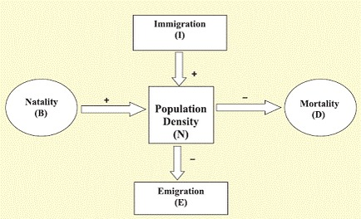

Slide 38
Population Growth
(i) Natality refers to the number of births during a given period in the population that are added to the initial density.
(ii) Mortality is the number of deaths in the population during a given period.
(iii) Immigration is the number of individuals of the same species that have come into the habitat from elsewhere during the time period under consideration.
(iv) Emigration is the number of individuals of the population who left the habitat and gone elsewhere during the time period under consideration.

Slide 39
GROWTH MODELS
(i) Exponential growth: Resource (food and space) availability is obviously essential for the unimpeded growth of a population.
Ideally, when resources in the habitat are unlimited, each species has the ability to realise fully its innate potential to grow in number, as Darwin observed while developing his theory of natural selection.
Then the population grows in an exponential or geometric fashion.

Slide 41
(ii) Logistic growth: No population of any species in nature has at its disposal unlimited resources to permit exponential growth.
This leads to competition between individuals for limited resources.
Eventually, the ‘fittest’ individual will survive and reproduce.
In nature, a given habitat has enough resources to support a maximum possible number, beyond which no further growth is possible. Let us call this limit as nature’s carrying capacity (K) for that species in that habitat.

Slide 42
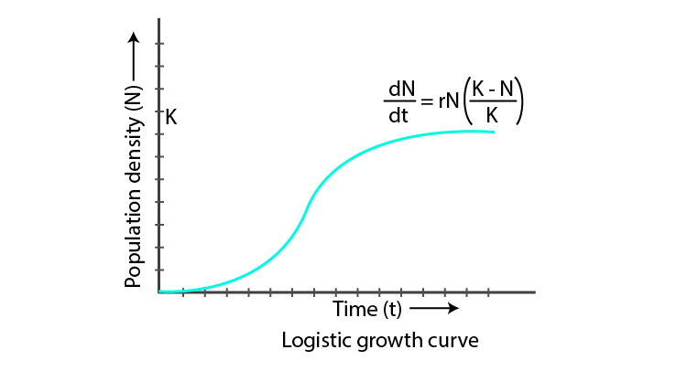

Slide 43
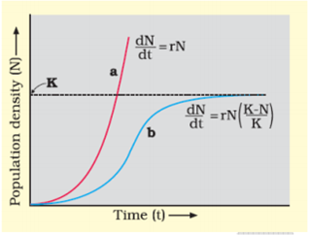

Slide 44
A population growing in a habitat with limited resources show initially a lag phase, followed by phases of acceleration and deceleration and finally an asymptote, when the population density reaches the carrying capacity.
A plot of N in relation to time (t) results in a sigmoid curve.
This type of population growth is called Verhulst-Pearl Logistic Growth (Figure 13.5) and is described by the following equation:
dN/dt =rN ( K- N/K)
Where N = Population density at time t r = Intrinsic rate of natural increase
K = Carrying capacity

Slide 45
Population Interactions
Interspecific interactions arise from the interaction of populations of two different species. They could be beneficial, detrimental or neutral (neither harm nor benefit) to one of the species or both.
Assigning a ‘+’ sign for beneficial interaction, ‘-’ sign for detrimental and 0 for neutral interaction, let us look at all the possible outcomes of interspecific interactions (Table13.1).

Slide 46
Population Interactions
Species A | Species B | Name of Interaction
+ | + | MUTULISM
- | - | Competition
+ | - | Predation
+ | - | Parasitism
+ | O | Commensalism
- | O | Amensalism

Slide 48
PREDATION
Besides acting as ‘conduits’ for energy transfer across trophic levels, predators play other important roles. They keep prey populations under control. But for predators, prey species could achieve very high population densities and cause ecosystem instability.

Slide 49
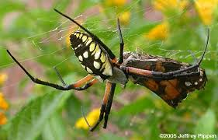
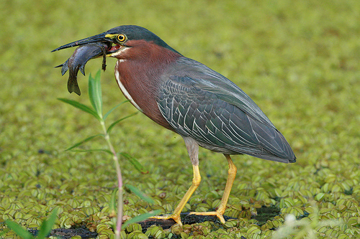
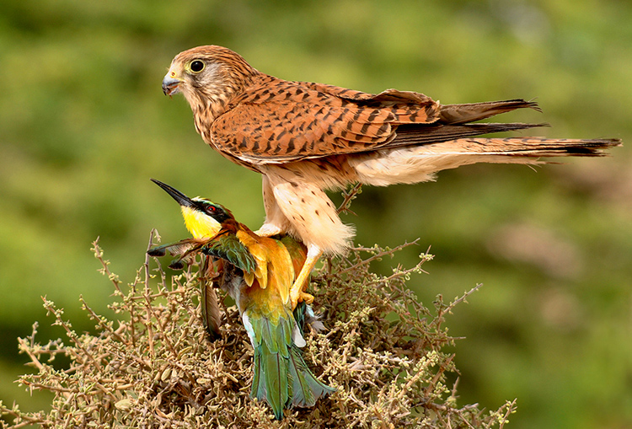
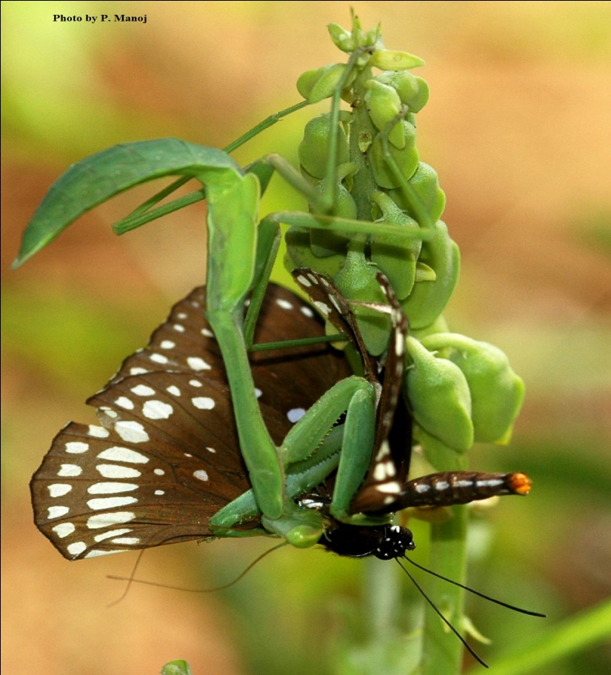
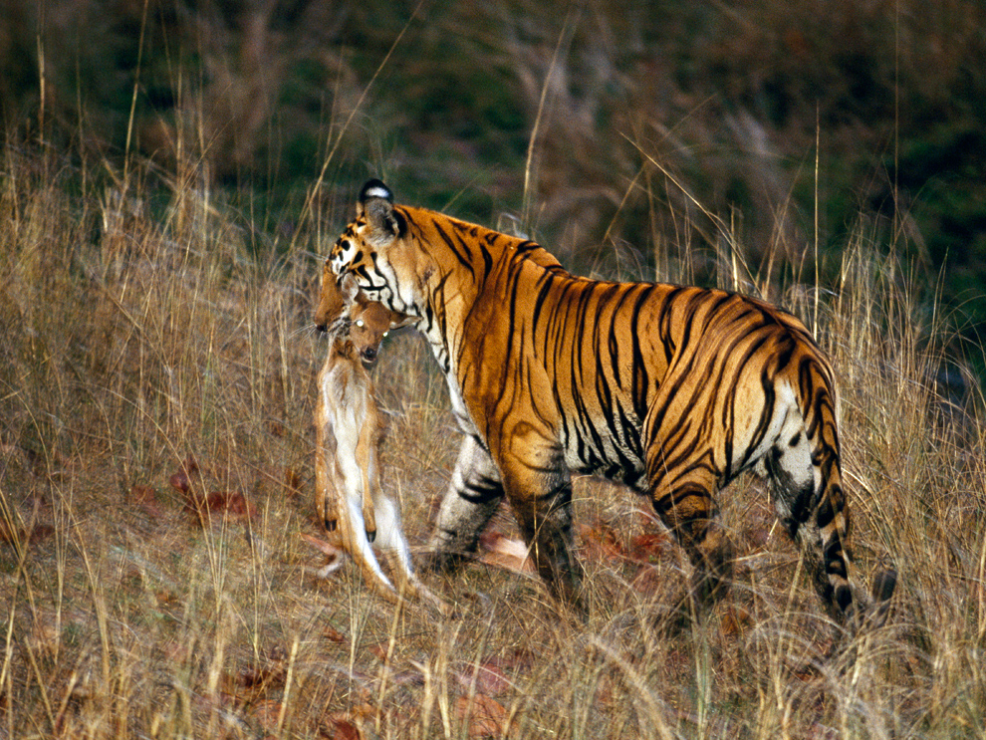
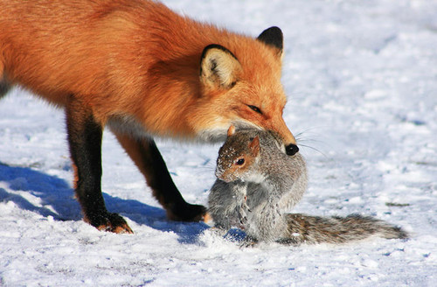
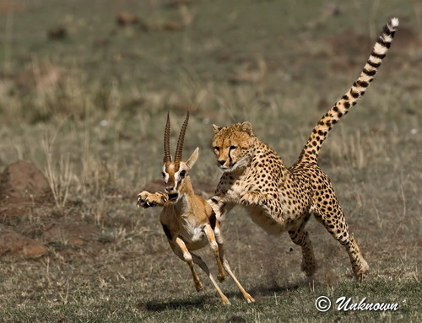
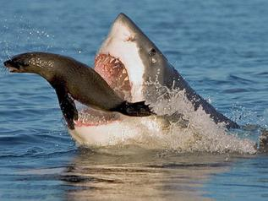
Predation: It is an interspecific interaction in which predator(strong animal) kills and consumes prey (weak animal). Therefore one species is benefit and other is harmed.
Predation is a way to transfer the energy from lower trophic levels to higher trophic levels.
Predator keep the prey population under control. Otherwise prey reach very high population density and cause imbalance in the ecosystem.

Slide 50
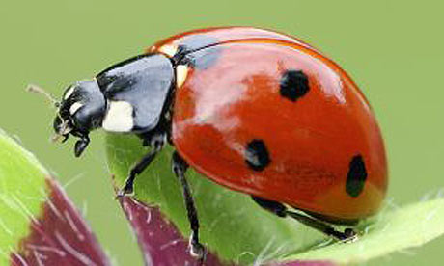
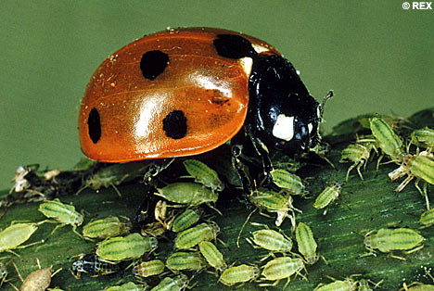
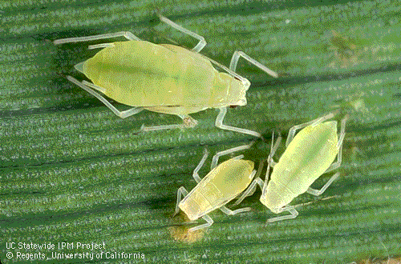
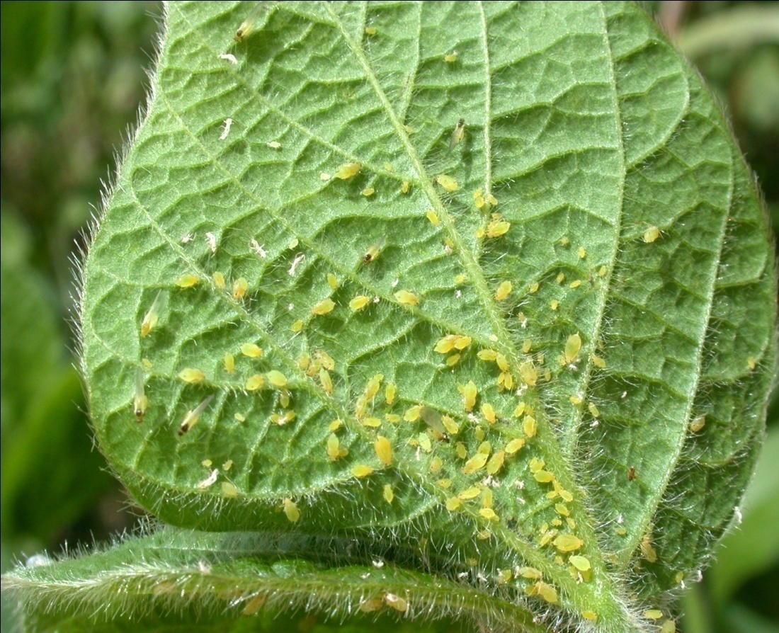
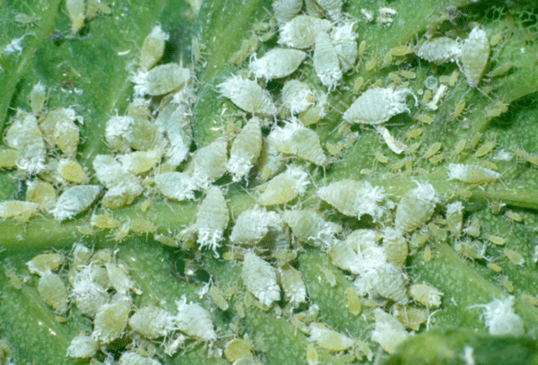
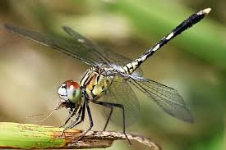
Sometimes predators are used as biological control for pests.
Example:
The Ladybird are useful to control aphids and Dragonflies for mosquitoes.

Slide 51
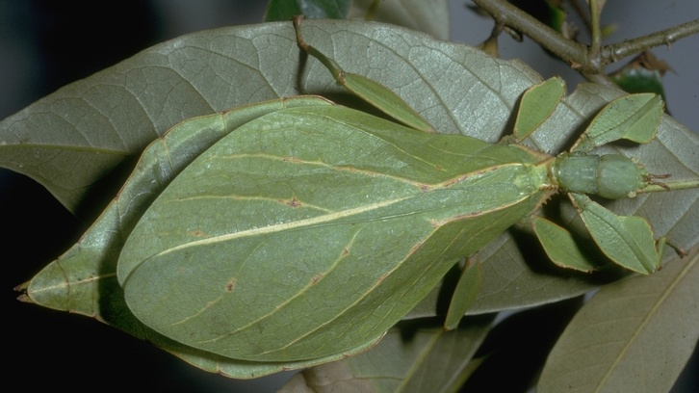
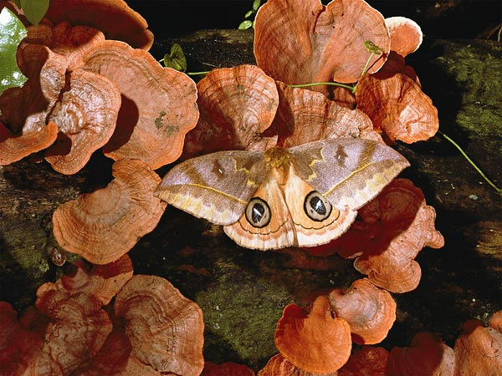
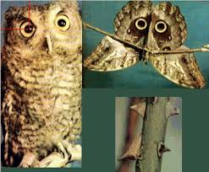
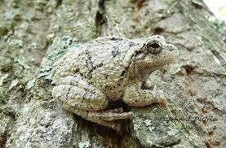
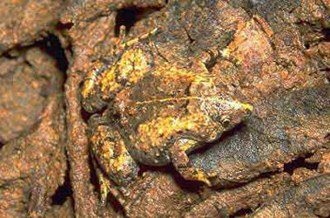
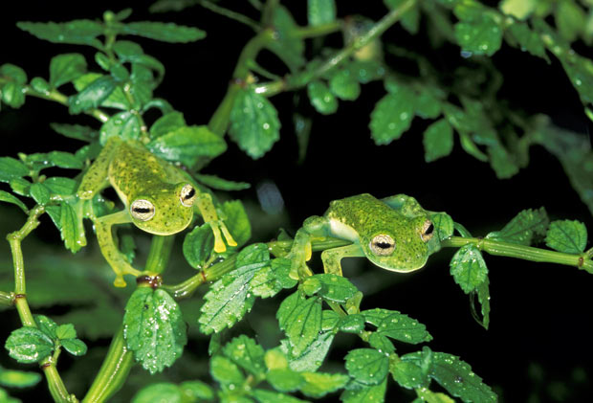
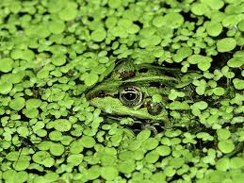
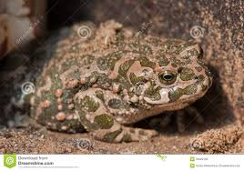
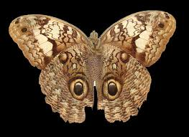
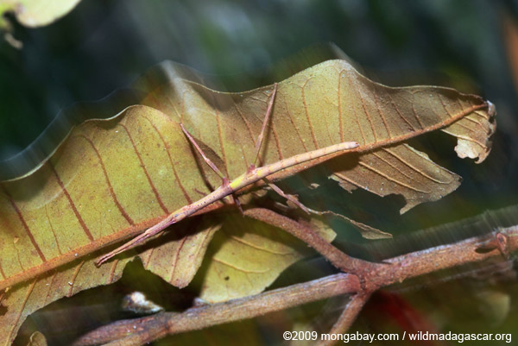
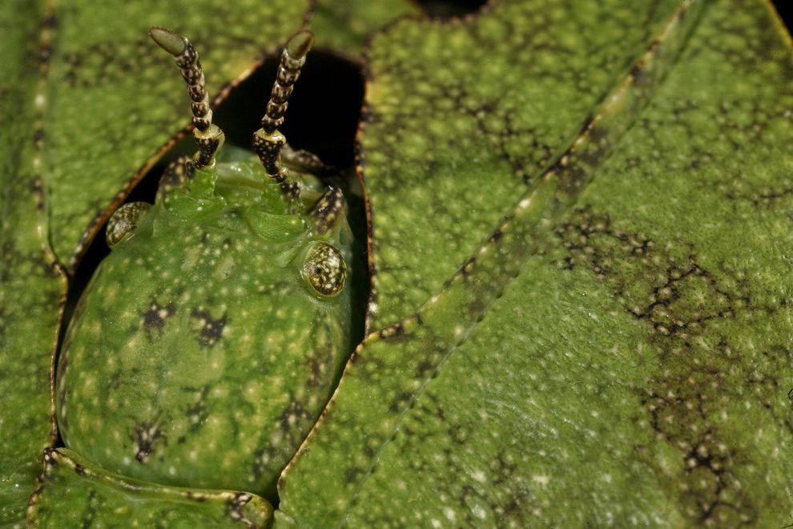
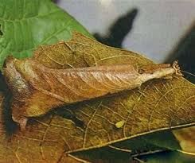
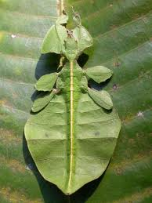
Prey species have evolved various defence mechanisms to reduce the impact of predation.
Example:
Certain insect species and frogs have camouflage (Cryptic coloration).

Slide 52
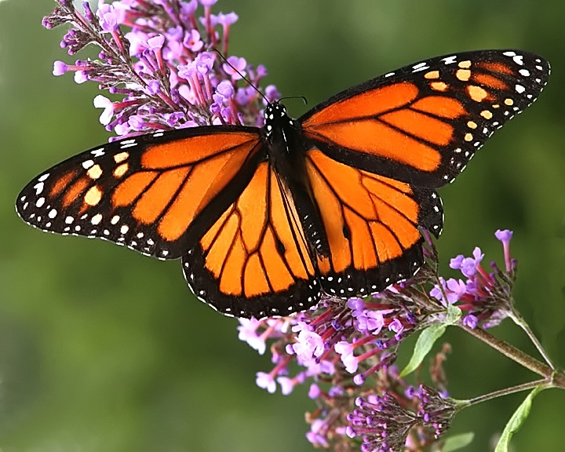
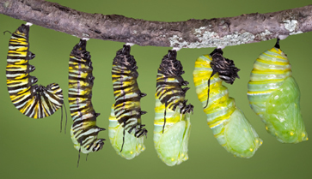
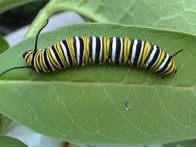
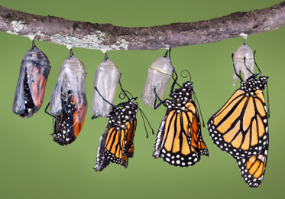
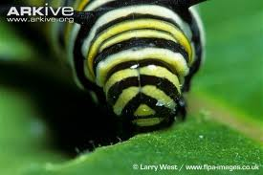
Monarch Butterfly is very distasteful to its prey bird. It has a special chemical in its body. This chemical is produced during its caterpillar stage by feeding on poisonous weeds.

Slide 53
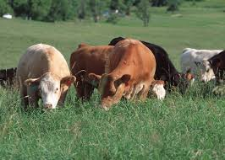
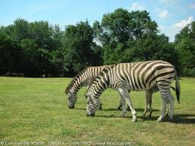
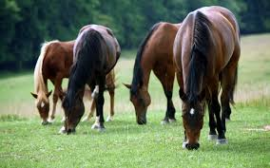
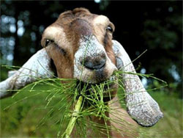
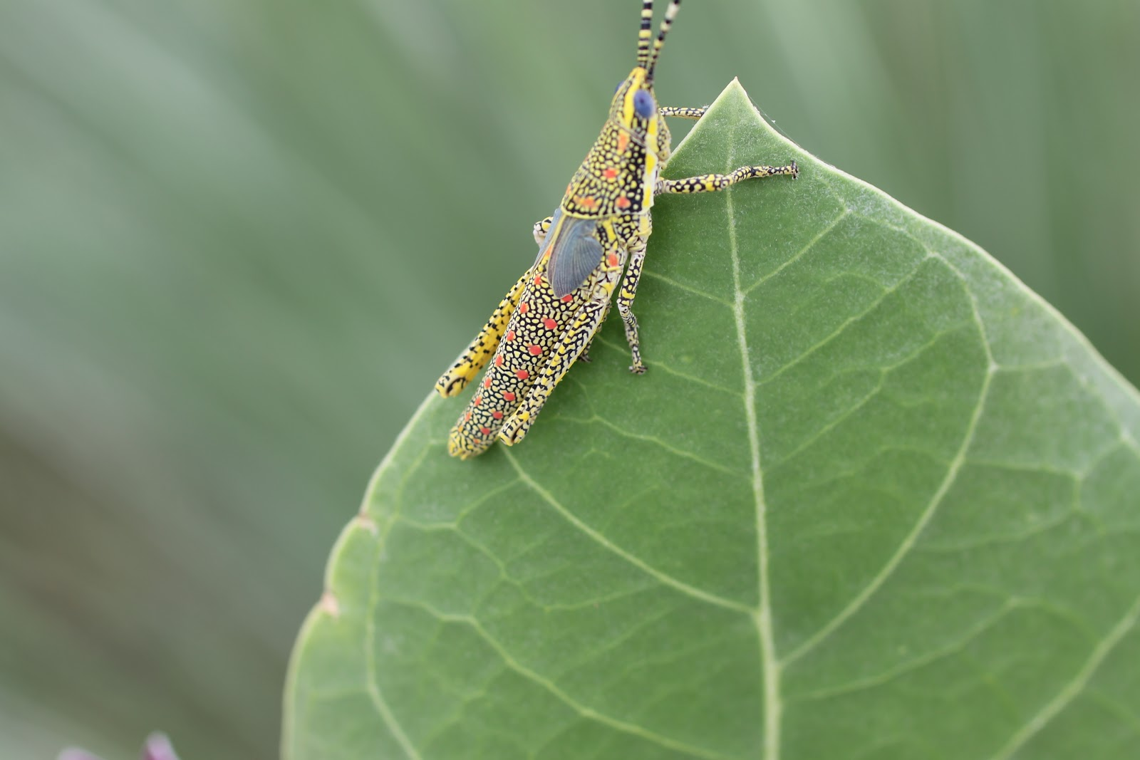
Herbivores are the predators for plants.
The problem of predation is more severe for plants than animals as they cannot move.
About 25% of the known insects are the Phytophagus and feed on the plant sap.

Slide 54
Plants have developed certain morphological and chemical defence mechanism against herbivores. E.g. Thorns in Bougainvillea and Spines in Acacia

Slide 55
Certain chemicals produced by the plants act for defense.
Calotropis produces a highly poisonous Glycoside that is a cardiac poison.
Nicotine, Caffeine, Quinine, Strychnine, Opium etc are the chemicals produced by the plants against herbivores.

Slide 57
The invasive cactus was brought under control only after a cactus-feeding predator (a moth) from its natural habitat.
Biological control methods adopted in agricultural pest control are based on the ability of the predator to regulate prey population.
Predators also help in maintaining species diversity in a community, by reducing the intensity of competition among competing prey species.

Slide 58
If a predator is too efficient and overexploits its prey, then the prey might become extinct and following it, the predator will also become extinct for lack of food. This is the reason why predators in nature are ‘prudent’.
Prey species have evolved various defenses to lessen the impact of predation.
Some species of insects and frogs are cryptically-coloured (camouflaged) to avoid being detected easily by the predator.

Slide 59
The Monarch butterfly is highly distasteful to its predator (bird) because of a special chemical present in its body.
Interestingly, the butterfly acquires this chemical during its caterpillar stage by feeding on a poisonous weed.

Slide 60
Nearly 25 per cent of all insects are known to be phytophagous (feeding on plant sap and other parts of plants).
Plants therefore have evolved an astonishing variety of morphological and chemical defences against herbivores. Thorns (Acacia, Cactus) are the most common morphological means of defence.

Slide 61
Many plants produce and store chemicals that make the herbivore sick when they are eaten, inhibit feeding or digestion, disrupt its reproduction or even kill it.
The weed Calotropis, produces highly poisonous cardiac glycosides and that is why you never see any cattle or goats browsing on this plant.
A wide variety of chemical substances that we extract from plants on a commercial scale (nicotine, caffeine, quinine, strychnine, opium, etc.,) are produced by them actually as defences against grazers and browsers.

Slide 62
(ii) Competition:
When Darwin spoke of the struggle for existence and survival of the fittest in nature,
He was convinced that interspecific competition is a potent force in organic evolution.
It is generally believed that competition occurs when closely related species compete for the same resources that are limiting, but this is not entirely true.
Firstly, totally unrelated species could also compete for the same resource.
Secondly, resources need not be limiting for competition to occur; in interference competition, the feeding efficiency of one species might be reduced due to the interfering and inhibitory presence of the other species, even if resources (food and space) are abundant.

Slide 65
GAUSE PRINCILPE
Gause’s ‘Competitive Exclusion Principle’ states that two closely related species competing for the same resources cannot co-exist indefinitely and the competitively inferior one will be eliminated eventually.
This may be true if resources are limiting, but not otherwise.

Slide 66
Competition:
Competition is an interaction among the individuals of same species (Intraspecific ) or between individuals of different species (Interspecific).
Competition between the individuals of same species is for same resources that are limited.
In some case, resources need not be limiting for competition to occur, the feeding efficiency of one species might be reduced due to the interfering of the other species.
E.g. Abingdon tortoise in Galapagos Island became extinct within a decade after goats were introduced into the island.
It was due to the fact that the goats had greater browsing efficiency than the tortoise.

Slide 67
Unrelated species also compete for same resources.
Ex:- flamingo & fish compete for zooplankton

Slide 68
Competitive release:
"A species, whose distribution is restricted to a small geographical area because of the presence of a competitively superior species is called competitive release.
These species is found to expand its distributional range dramatically when the competing species is experimentally removed
Gause’s Competitive Exclusion Principle : It states, ‘that two closely related species competing for the same resources cannot exist together and the competitively inferior will be eliminated by superior’.
Resource Partitioning: It is the mechanism meant for co-existence of species to face competition .
According to this, if two species compete for the same resource, they could avoid competition by choosing different times for feeding or different foraging patterns.

Slide 69
E.g.
MacArthur showed that five closely related species of Warbles living on the same tree were able to coexist and avoid competition by having behavioral differences in their foraging( hunting) activities.

Slide 72
Parasitism:
The life cycles of parasites are often complex, involving one or two intermediate hosts or vectors to facilitate parasitisation of its primary host.
The human liver fluke (a trematode parasite-Trematoda is a class within the phylum Platyhelminthes. It includes two groups of parasitic flatworms, known as flukes. They are internal parasites of molluscs and vertebrates) depends on two intermediate hosts (a snail and a fish) to complete its life cycle.

Slide 73
Majority of the parasites harm the host; they may reduce the survival, growth and reproduction of the host and reduce its population density.
They might render the host more vulnerable to predation by making it physically weak.

Slide 74
Parasitism:
Parasitism is the interspecific interaction where one of the species (Parasite) depends the other species (Host)for food and shelter.
Host gets harmed and parasite gets benefitted.
Parasites are host-specific and parasite and its host tend to co-evolve.
Co-evolve: It means that if the host evolves a special mechanism to reject or resist the parasite, the parasite has to evolve the mechanisms to neutralize them.
Parasites adaptations:
Parasite tends to co-evolve.
It may loss of sense organs.
Presence of suckers or hooks.
Loss of digestive system.
High reproductive capacity.

Slide 75
Some parasites have complex life cycle and generally have one or two intermediate host.
Intermediate hosts act as vectors which facilitates parasitisation of host.
Human liver fluke has two intermediate hosts: a snail and a fish
Malaria Parasite has one intermediate host (mosquito) to spread to other host.

Slide 76
Human lice and ticks are ectoparasites
Copepods are the ectoparasites on some marine fish.
Cuscuta is a parasitic plant that grows on the trees or shrubs.
It lost its chlorophyll and leaves during evolution.
It gets its nutrition from the host plants by haustoria.

Slide 77
ECTOPARASITES
Parasites that feed on the external surface of the host organism are called ectoparasites.
The most familiar examples of this group are the lice on humans and ticks on dogs. Many marine fish are infested with ectoparasitic copepods.
Cuscuta, a parasitic plant that is commonly found growing on hedge plants, has lost its chlorophyll and leaves in the course of evolution. It derives its nutrition from the host plant which it parasitises.

Slide 78
PARASITIC ROOTS
IN CUSCUTA
Haustoria
Penetrate into host
stem & enter
vascular bundles
which absorb
materials.

Slide 79
ENDOPARASITES
Endoparasites are those that live inside the host body at different sites (liver, kidney, lungs, red blood cells, etc.).
The life cycles of endoparasites are more complex because of their extreme specialisation.
Their morphological and anatomical features are greatly simplified while emphasising their reproductive potential.

Slide 80
Brood parasitism
Brood parasitism in birds is a fascinating example of parasitism in which the parasitic bird lays its eggs in the nest of its host and lets the host incubate them.
During the course of evolution, the eggs of the parasitic bird have evolved to resemble the host’s egg in size and colour to reduce the chances of the host bird detecting the foreign eggs and ejecting them from the nest.
The movements of the cuckoo (koel) and the crow in your neighborhood park during the breeding season (spring to summer) and watch brood parasitism in action.

Slide 81
(iv) Commensalism:
This is the interaction in which one species benefits and the other is neither harmed nor benefited.
An orchid growing as an epiphyte on a mango branch, and barnacles growing on the back of a whale benefit while neither the mango tree nor the whale derives any apparent benefit.
Another example of commensalism is the interaction between sea anemone that has stinging tentacles and the clown fish that lives among them.
The fish gets protection from predators which stay away from the stinging tentacles.
The anemone does not appear to derive any benefit by hosting the clown fish.

Slide 82
Commensalism:
It is the interspecific interaction in which one species benefits and the other is neither harmed nor benefitted.
Ex: Epiphytes i.e Orchids growing on a tree branch.
Barnacles growing on the back of whales.
Association between Egret and grazing cattle. Egrets always forage close to cattle are grazing because they easily get insects.
The Clown fish living along with sea anemones. Clown fish get protection from predators.
Sucker fish on the back of shark

Slide 83
(v) Mutualism:
This interaction confers benefits on both the interacting species.
Lichens represent an intimate mutualistic relationship between a fungus and photosynthesising algae or cyanobacteria.
Similarly, the mycorrhizae are associations between fungi and the roots of higher plants.
The fungi help the plant in the absorption of essential nutrients from the soil while the plant in turn provides the fungi with energy-yielding carbohydrates.

Slide 84
Mutualism: It is the interspecific interaction in which Both the species interact gets benefit.
E.g. Lichens are relationship between Fungus and Algae/ Cyanobacteria
Mycorrhiza – an association of Fungus with roots of higher plants. Fungi help to absorb nutrients from the rocks and plants provide energy yielding carbohydrates to fungi.
Plants depend on insects for pollination and in return they give them nectar or pollens to eat.
Animals help the plants in seed dispersal and in return they give fruits to animals as food.

Slide 85
fig tree and pollinator species of wasp. Fig species can be pollinated by its partner wasp only.

Slide 86
Amensalism: It is the interspecific interaction in which one is harmed and the other is neither benefited nor harmed.
E.g: Penicillium secretes chemical penicillin kills bacteria. Name the interaction in each of the following:
a) Cuscuta growing on a shoe flower plant.
b) Mycorrhizaa living on the roots of higher plants.
c) Clown fish living among the tentacles of sea anemone.
d) Koel laying her eggs in crow's nest.
e) Five closely related species of warblers living on the same tree
a. Parasitism
b. Mutualism
c. Commensalism
d. Brood parasitism
e).Competition with resource partitioning.

